Slide 1
Boosting Algorithms
Machine Learning

Slide 2
What is Boosting in Machine Learning?
Boosting refers to the process of creating a strong learner from a collection of weak learners. A weak learner is a model that performs only slightly better than random guessing on the training data. By iteratively adjusting the weights of the training instances, boosting algorithms assign higher importance to misclassified instances, forcing subsequent weak learners to focus on these challenging samples. The final prediction is determined by aggregating the predictions of all weak learners, with higher emphasis placed on those that demonstrate superior performance.

Slide 3
AdaBoost (Adaptive Boosting)
AdaBoost is the most popular boosting algorithms.
It assigns weights to training instances and adjusts these weights based on the performance of weak learners.
It focuses on misclassified instances, allowing subsequent weak learners to concentrate on these samples.
The final prediction is determined by aggregating the predictions of all weak learners through a weighted majority vote.

Slide 4
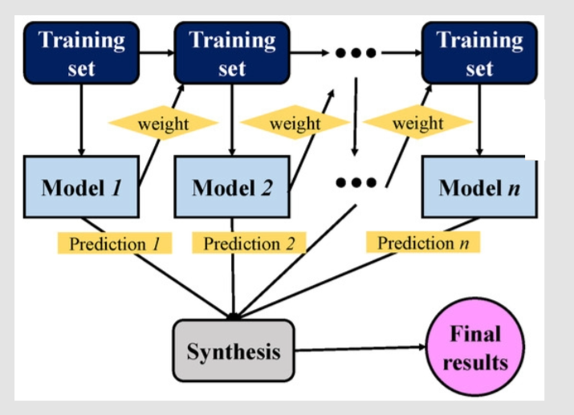
AdaBoost (Pictorial Representation)

Slide 5
XGBoost (Extreme Gradient Boosting)
XGBoost is an advanced boosting algorithm that combines gradient boosting with regularization techniques.
It incorporates both tree-based models and linear models to enhance performance and efficiency.
It uses a combination of gradient boosting and regularization strategies to prevent overfitting.
It is known for its speed, scalability and ability to handle large-scale datasets effectively.

Slide 6
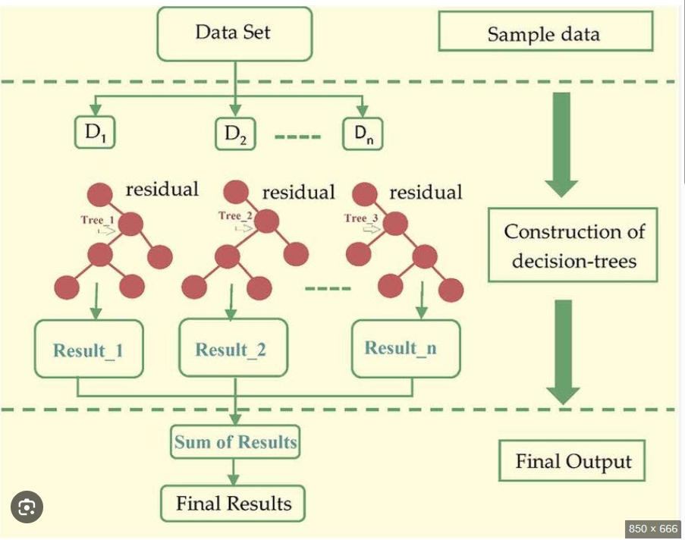
XGBoost (Pictorial Representation)

Slide 7
LG Boosting (Light Gradient Boosting)
LightGBM is a high performance boosting algorithm that uses a leaf-wise approach to construct decision trees.
It prioritizes growing the leaf nodes that reduce the loss the most, resulting in faster training times.
It is particularly efficient when dealing with large datasets and is widely used in competitions and industry applications.

Slide 8
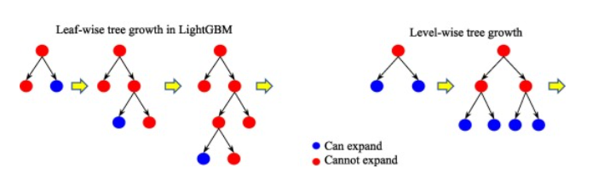
LG Boosting (Pictorial Representation)

